Slide 1
Movie Recommender System.
Here is where your presentation begins
05/11/2023
225
#2

Slide 2

Group Member
Mr. Sagar Sarkar Ms. Supriya I Ms. Priyanka Houde
Ms. Shruti Upadhyay Mr. Hemanshu Makwana

Slide 3
Table of Contents.
Objectives
Collection & EDA
Visualization
Methodology
Deployment
Snapshots
01
02
03
Problem Statement
Data collection,
Check for Null values
Average Rates, Average gross collection, Rate by Certificate, Average Votes, Average Watch Time, Watch Time by Rate
04
05
06
Content-based filltering
Deploying model on internet
Images of web-app

Slide 4
Objectives
01
Problem statement

Slide 5
Objective
Problem Statement
Scrape Movie dataset from IMDB, perform analysis for deeper insights and build a recommendation system.

Slide 6
EDA
02
Data collection
Null values

Slide 7
Collection
Data collection
1. Utilized the BeautifulSoup library in Python for web scraping IMDb data. 2. Extracted relevant information such as movie name, year ,rating , meta score, gross income, votes ,genre ,certificate, directors, descriptions, and stars from IMDb web pages. 3. Implemented parsing techniques to retrieve structured data from the IMDb website.

Slide 8
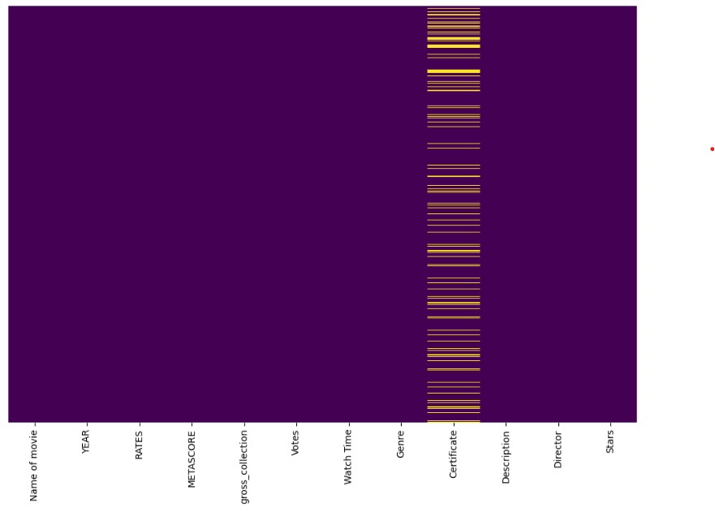
EDA
Null values
The 'Certificate' column contains a significant number of null values.

Slide 9
Visualisation
03
Average Rates, Average gross collection, Rate by Certificate, Average Votes, Average Watch Time, Watch Time by Rate

Slide 10
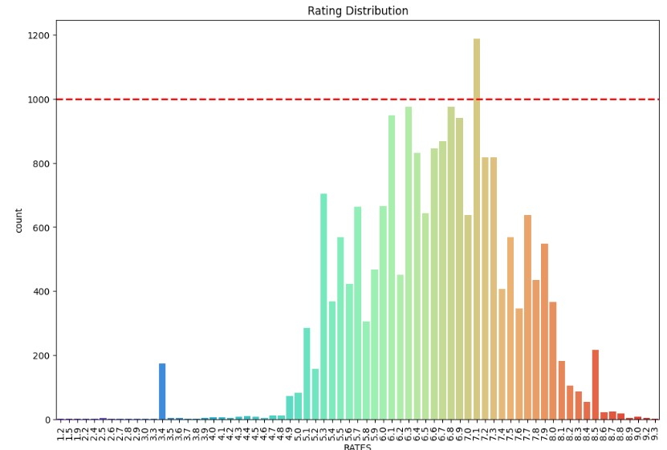
Audience Ratings Analysis
Preferred Rating Score: Most of the people prefer to rate 7.1
Rating Distribution: Mostly the ratings are between 6 to 7.

Slide 11
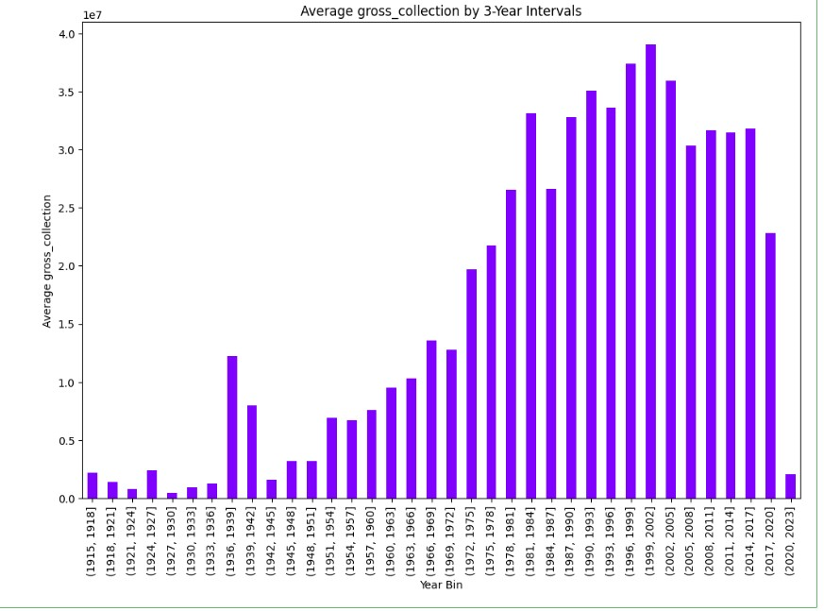
Box Office Trends Analysis
Historical Box Office Performance: Higher gross collection has been observed between 1999 to 2002
Impact of COVID-19 Pandemic: Due to the impact of the COVID-19 pandemic, there has been a significant decline in gross collections over the past three years

Slide 12
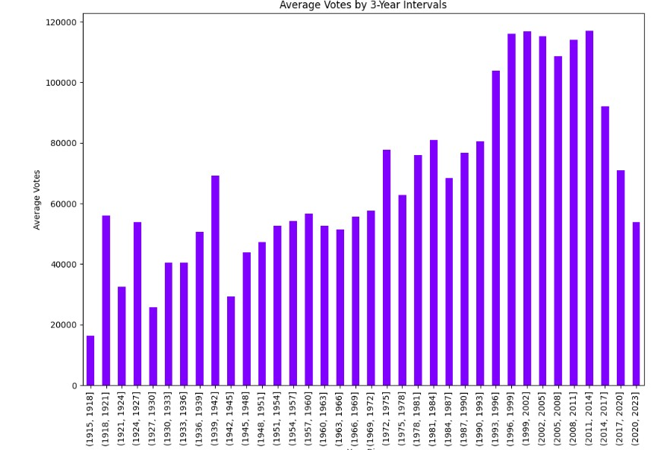
Voting Trends Analysis
Historical Voting Patterns: The number of votes cast experienced a substantial surge during the period from 1996 to 2002 Factors Driving Engagement: Increased Accessibility and Interactivity: Enhanced accessibility to movie rating platforms and increased interactivity with online communities facilitated a surge in audience participation during the specified period.
Expansion of Internet and Digital Platforms: The widespread expansion of the internet and the emergence of digital platforms provided audiences with greater opportunities for engagement, leading to a notable increase in voting activity.

Slide 13
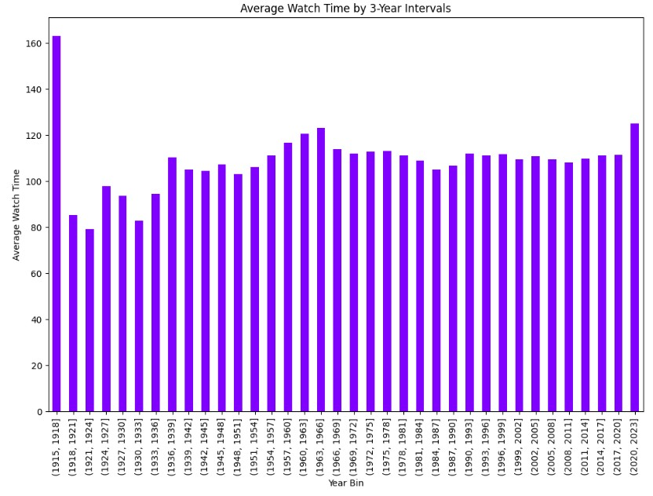
Early Film Watch Time Analysis
Historical Movie Watch Trends: Movies between 1915 to 1918 contain higher watch time
Cinematic Evolution:
Narrative and Technological Progression: The cinematic evolution from 1915 to 1918 marks a pivotal period characterized by significant advancements in both narrative storytelling and film production technology, laying the foundation for modern filmmaking practices.

Slide 14
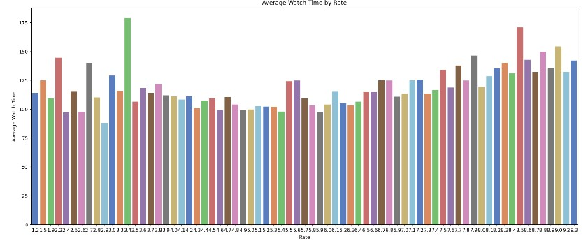
Movie Duration and Ratings Analysis
Impact of Movie Duration: Movies with a duration of 2 hours or more are more likely to receive favorable ratings
Audience Preference Analysis:
Engagement and Emotional Investment: The preference for movies with extended durations suggests that audiences are inclined towards films that allow for deeper emotional engagement and a more profound connection with the characters and storyline.

Slide 15
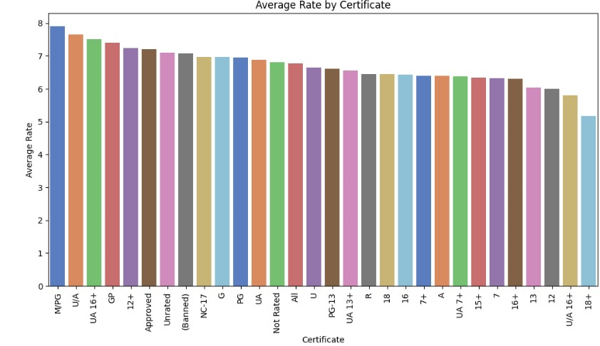
Movie Rating and Audience Approval Analysis
Impact of Audience Classifications: Movies rated for 'mature audiences' or 'parental guidance suggested' (M/PG) often receive higher viewer approval
Analysis of Viewer Perceptions:
Cultural Sensitivities and Content Relevance: Analysis of viewer perceptions reveals a heightened appreciation for M/PG-rated movies, emphasizing the cultural sensitivities and content relevance that contribute to viewer engagement and approval.

Slide 16
Methodology
04

Slide 17
Methodology
1. Our Movie Recommendation System employs **Content-Based Filtering**, which recommends items similar to those a user has previously liked.
2. The system uses **TF-IDF** to highlight important words in movie descriptions and **Cosine Similarity** to measure the similarity between movies.
3. The combination of these techniques enables the system to provide personalized movie recommendations based on the attributes of the movies.
4. This approach is effective for analyzing textual data and is widely used in natural language processing and information retrieval.

Slide 18
Deployment
05
Deploying model on internet

Slide 19
Deployment
For the Deployment we used Streamlit which provides us with simple easy to write script to create minimal web-page.
We have utilized Visual Studio, an integrated development environment (IDE) for cross-platform application development, including scientific programming in the Python language.
Access the Deployed Application: https://movie-recommendation-h.streamlit.app/

Slide 20
Snapshots
06
Images of web-app

Slide 21
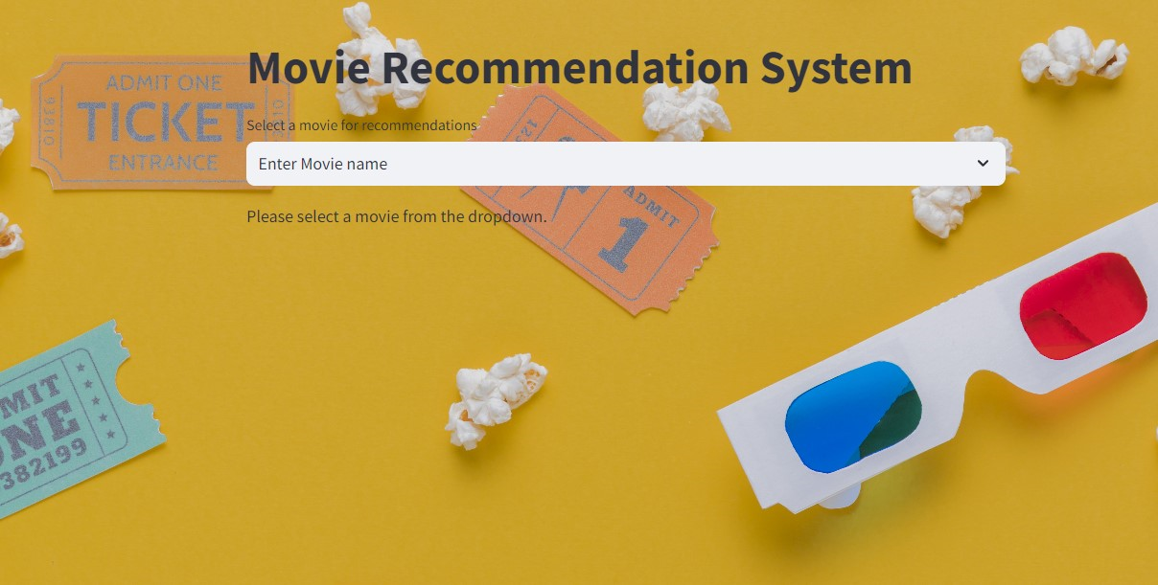
Deployment snapshots

Slide 22
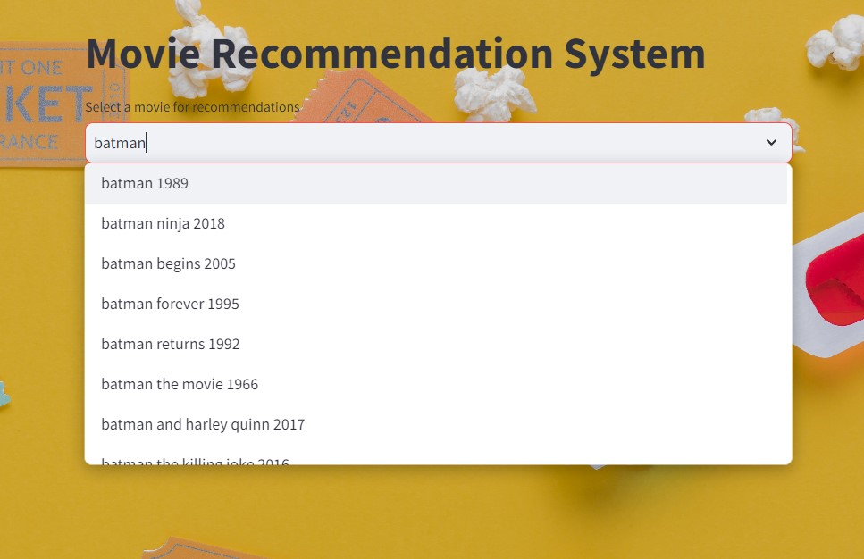
Deployment snapshots

Slide 23
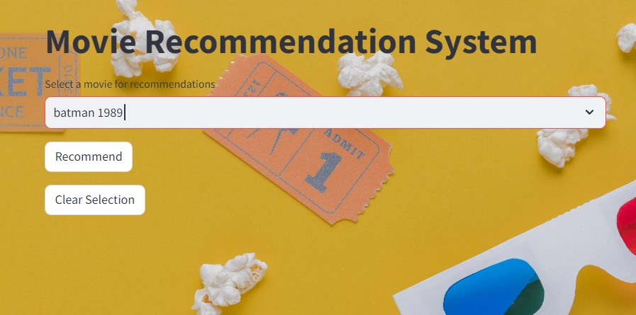
Deployment snapshots

Slide 24
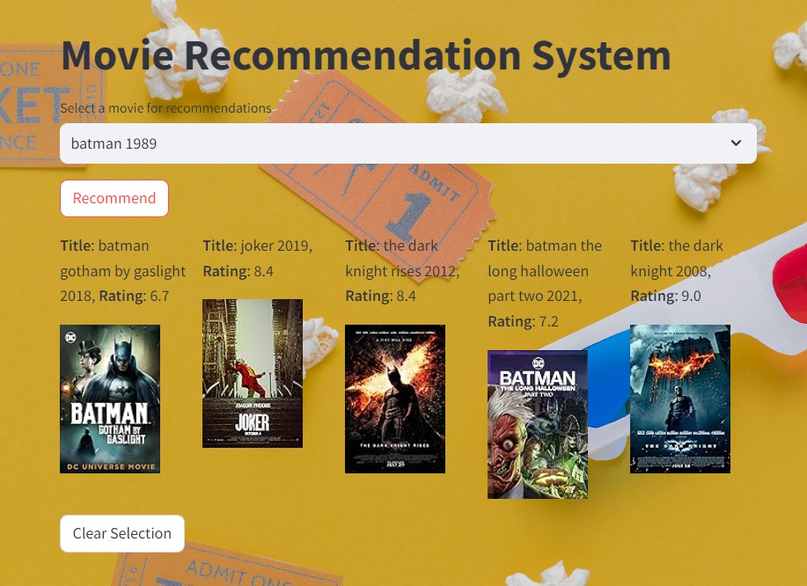
Deployment snapshots

Slide 25
Thank you!

